Slide 1

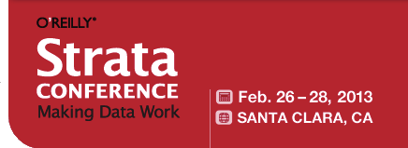


Jim Adler
VP Data Systems & Chief Privacy Officer
inome
@jim_adler
http://jimadler.me
inome
The Genomics of How We All Fit Together

Slide 2
Overture & 3 Acts
About inome
Strata Redux
Felon Classifier
Closing Arguments

Slide 3

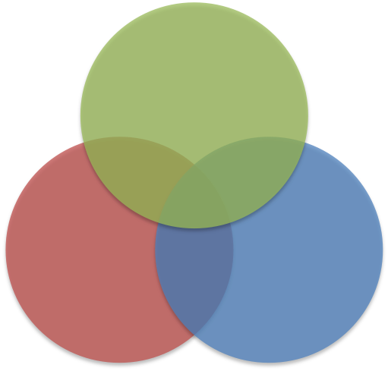
Intelligence
I am not an
Attorney
Geek
Dweeb
Nerd
Social
Ineptitude
Obsession
Dork

Slide 4
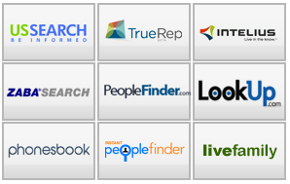


About inome
Real-time, person-centric data engine
Structured and unstructured data
10 years in the making
Scalable – serves over 1 million visitors a day
APIs support 3rd party apps – http://developer.inome.com

Slide 5
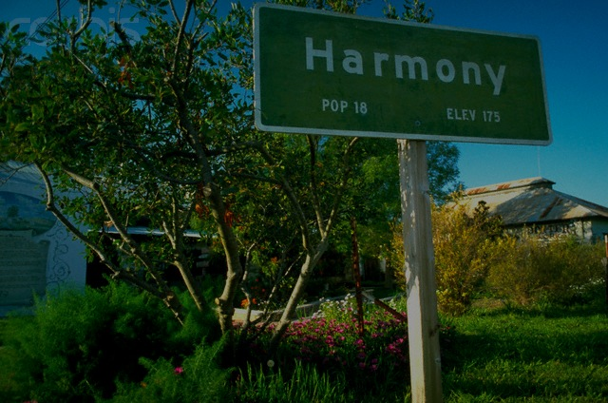
When towns were small …

Slide 6
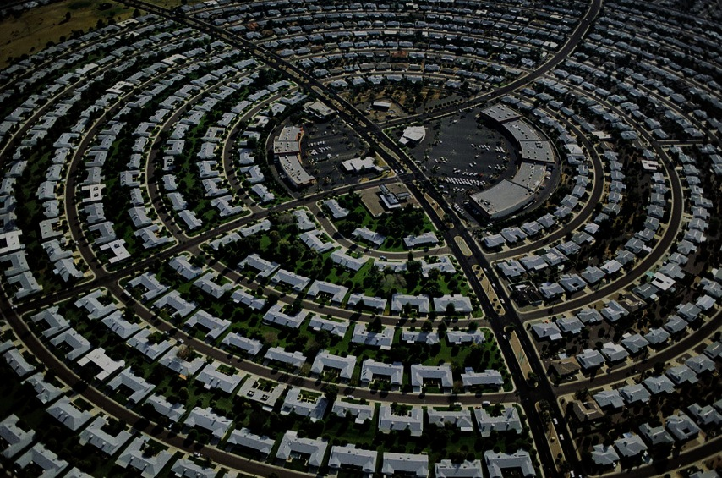


INFORMATION
SOCIAL GENOMICS
INTERACTION

Slide 7


inome is bringing the
“local village” back

Slide 8
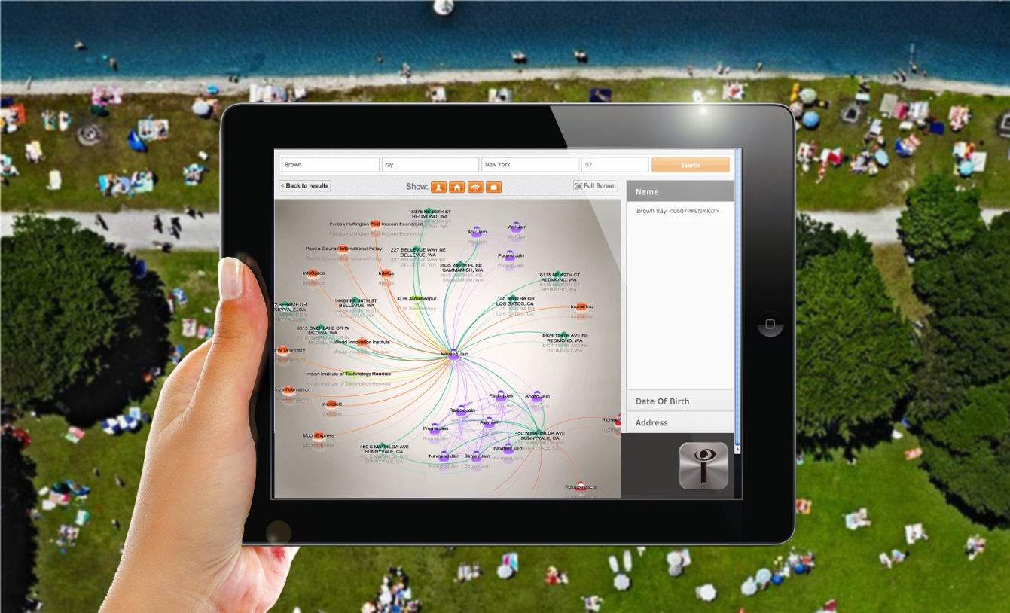
HOW WE ALL FIT TOGETHER

Slide 9
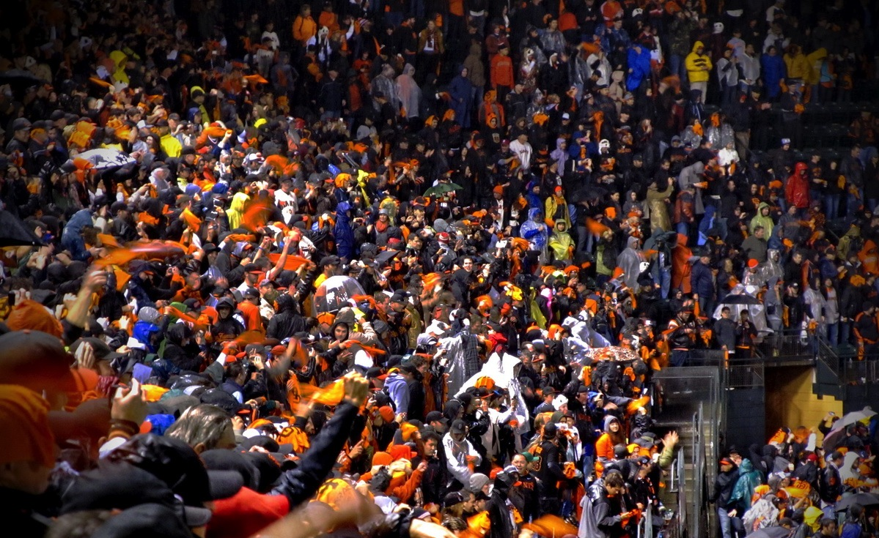

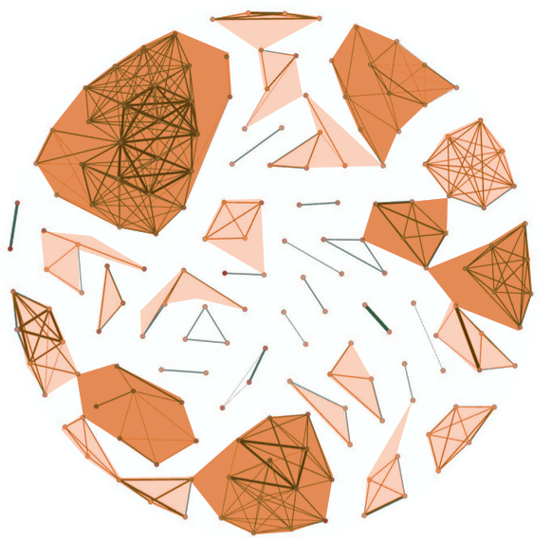
HOW INOME SOLVES THE
“BIG DATA” PEOPLE PROBLEM
Billions of Records
Millions of People
213 records mapped
to the correct 37 Jim Adlers
Philip Collins
375 People
Randolph Hutchins
5 People
Jim Adler
213 Records
37 People
Jim Adler
McKinney, TX
Age 57
Jim Adler
Houston, TX
Age 68
Carol Brooks
9800 Records
1250 People
Gwen Fleming
2 People
Jim Adler
Hastings, NE
Age 32
Jim Adler
Canaan, NH
Age 59
Jim Adler
Redmond, WA
Age 48
Jim Adler
Denver, CO
Age 48

Slide 10
THE INOME ENGINE
Names
Places
Phones
inome Data
Model
(IDM)
Court Records
Data
Exchange
News/Blogs
Data
Acquisition
Professional
Relatives
Acquire, Standardize,
Validate, Extract
Friends
Colleagues
Features
Full Text
Search
Index
Machine
Learners
Document
Store
Clustering
Blocking
http://developer.inome.com
APIs

Slide 11
Act 1
Strata Redux

Slide 12
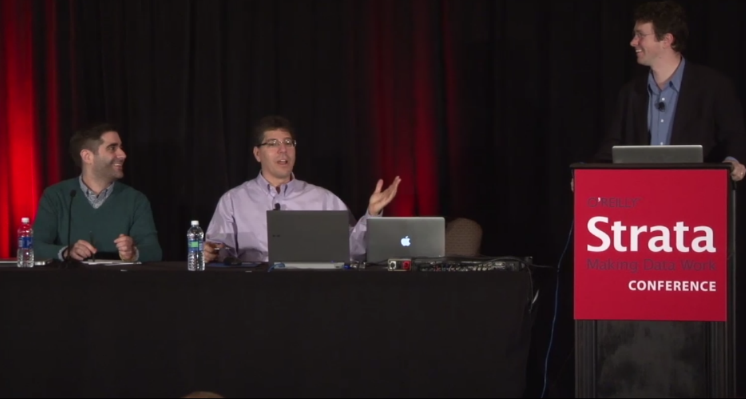
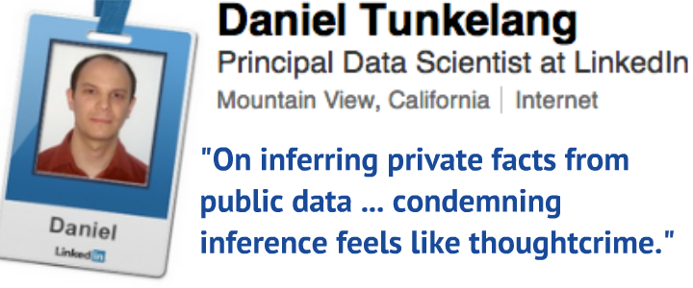

Slide 13
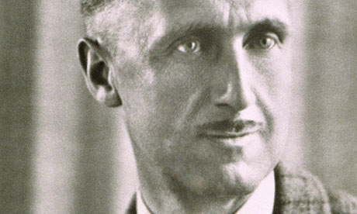
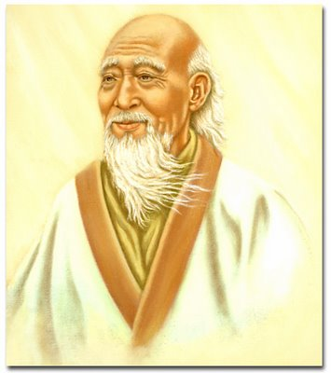
… the essential crime that contained all others in itself. Thoughtcrime, they called it."
George Orwell
"Watch your thoughts, they become words.
Watch your words, they become actions.
Watch your actions, they become habits.
Watch your habits, they become your character.
Watch your character, it becomes your destiny.”
Lao Tzu

Slide 14
The Places-Players-perils privacy Framework
PRIVACY
PLACES
PLAYERS
PERILS
http://jimadler.me/post/14171086020/creepy-is-as-creepy-does
http://jimadler.me/post/18618791545/strata-2012-is-privacy-a-big-data-prison

Slide 15
Places-Players-perils Cases
MORE PLAYER POWER GAP
MORE PRIVATE PLACES

Slide 16
Act 2
Felon Classifier
Contributors
Jeremy Kahn, Senior Scientist
Deepak Konidena, Software Engineer

Slide 17
THE Classifier’s Goal
If someone has minor offenses
on their criminal record,
do they also have any felonies?

Slide 18
Motivations
Ask the hard questions
Convene the suits, wonks, and geeks
Drive responsible innovation
Explore the data & showcase the technology

Slide 19
A Few DEFINITIONS
Definition
  Positive → Has at least one felony
  Negative → Has no felonies but does have lesser offenses
Classifier Performance
  True Positive → Correctly identifies a felon
  True Negative → Correctly ignores someone who isn’t a felon
  False Positive → Incorrectly identifies a felon who isn’t one
  False Negative → Incorrectly ignores a felon

Slide 20
DATA EXTRACTION And Cleansing
250 M Defendants
(avro files)
Alabama
Data Acquisition
Data Exchange
Blocking
Linking
Clustering
Delaware
40 M Defendants
Florida
Noise
Filter
15K Labels
Kentucky: 60 K
State Fan-Out
Ohio
15K Predictors
Texas
Virginia
INOME ENGINE

Slide 21
EXAMPLE DATA
Prediction Data
key: e926f511b7f8289c64130a266c66411e
val:
offenses:
- {CaseID: MDAOC206059-2, CaseInfo: 'CASE DISPO: TRIAL, CJIS CODE: 3 5010', Disposition: STET,
Key: hyg-MDAOC206059, OffenseClass: M, OffenseCount: '2', OffenseDate: '20041205',
OffenseDesc: 'THEFT:LESS $500 VALUE'}
- {CaseID: MDAOC206060-1, CaseInfo: 'CASE DISPO: TRIAL, CJIS CODE: 1 4803', Disposition: GUILTY,
Key: hyg-MDAOC206060, OffenseClass: M, OffenseCount: '1', OffenseDate: '20040928',
OffenseDesc: FALSE STATEMENT TO OFFICER}
profile: {BodyMarks: 'TAT L ARM; ,TAT L SHLD: N/A; ,TAT R ARM: N/A; ,TAT R SHLD:
N/A; ,TAT RF ARM; ,TAT UL ARM; ,TAT UR AR', DOB: '19711206', DOB.Completeness: '111',
EyeColor: HAZEL, Gender: m, HairColor: BROWN, Height: 5'8", SkinColor: FAIR,
State: 'DE,MD,MD,MD,MD,MD,MD,MD,MD,MD,MD,MD,MD’, Weight: 180 LBS}
Training Labels
key: e926f511b7f8289c64130a266c66411e
val:
label: true
offenses:
- {CaseID: MDAOC206065-4, CaseInfo: 'CASE DISPO: TRIAL, CJIS CODE: 1 6501', Disposition: NOLLE
PROSEQUI, Key: hyg-MDAOC206065, OffenseClass: F, OffenseCount: '1', OffenseDesc: ARSON
2ND DEGREE}

Slide 22
Model Training
INOME Person Profile
Prediction
Data
Profile
Information
Non-Felony Offense
Information
Features
Model
Learn
Training
Labels
Felony Offense
Information
Model Operation
INOME Person Profile
Model
Prediction
Data
Person
Information
Non-Felony Offense
Information
Has any felonies?

Slide 23
MODEL FEATURES
Personal Profile
Criminal Profile
Person.NumBodyMarks
Person.HasTattoo
Person.IsMale
Person.HairColor
Person.EyeColor
Person.SkinColor
Offenses.NumOffenses
Offenses.OnlyTraffic

Slide 24
EXAMPLE Feature
class EyeColor(Extractor):
normalizer = {
'bro': 'brown’,'blu': 'blue', 'blk': 'black', 'hzl': 'hazel’,
'haz’: 'hazel’, 'grn': 'green’}
schema = {'type': 'enum', 'name': 'EyeColors',
'symbols': ('black', 'brown', 'hazel', 'blue',
'green', 'other', 'unknown')}
def extract(self, record):
recorded = record['profile'].get('EyeColor', None)
if recorded is None:
return 'unknown'
recorded = recorded.lower()
if recorded in self.normalizer:
recorded = self.normalizer[recorded]
for i in self.schema['symbols']:
if recorded.startswith(i):
recorded = i
if recorded in self.schema['symbols']:
return recorded
else:
return 'other'

Slide 25
The Code
Gasket – an inome functional toolset for data extraction
  Avro, Json, and Yaml
Gemini – an inome framework for feature extraction and learning
    Domain knowledge feature extractors
    Model construction from features and labels
Felon detector available now: http://github.com/inome/strataconf-2013-sc

Slide 26
FELON CLASSIFIER performance
Threshold: 1.01
FP Rate: 1%
FN Rate: 40%
ANARCHY
Threshold: 0.66
FP Rate: 5%
FN Rate: 22%
Threshold: -1.82
FP Rate: 19%
FN Rate: 0%
TYRANNY

Slide 27
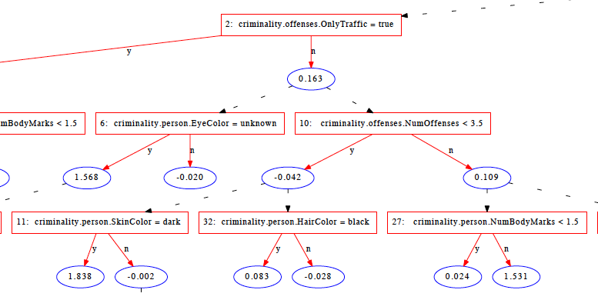
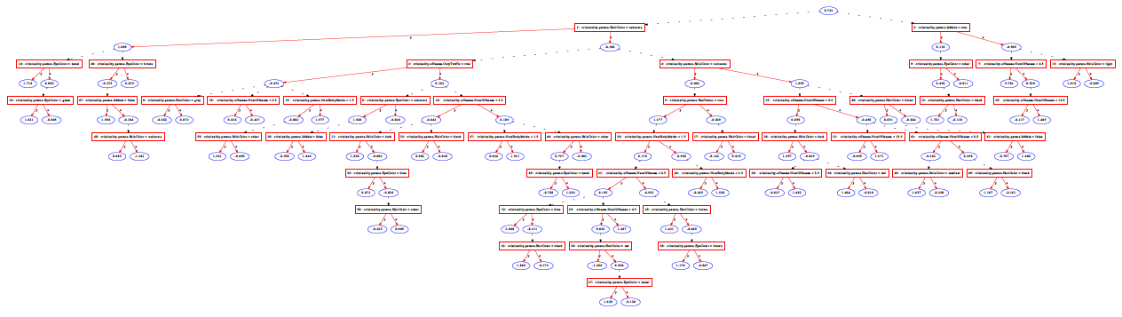
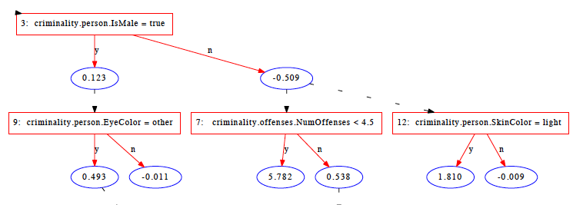
Alternating decision tree

Slide 28
Act 3
Closing Arguments

Slide 29
MORE PLAYER POWER GAP
Public data used by
powerful government players resulting in
perilous consequences like
stop, seizure, arrest, and imprisonment
MORE PRIVATE PLACES

Slide 30

From Inferences to Actions
Fourth Amendment checks gov’t abuses
Principles of reasonable suspicion
Geographic Profiling
Criminal Profiling
References
  Predictive Policing
  Andrew Guthrie Ferguson, U of District of Columbia Law
  http://ssrn.com/abstract_id=2050001
  Rethinking Racial Profiling
  Bernard Harcourt, U Chicago Law
  http://www.law.uchicago.edu/files/files/rethinking_racial_profiling.pdf
  Looking at Prediction from an Economics Perspective
  Yoram Margalioth
  http://bernardharcourt.com/documents/margalioth-againstprediction.pdf

Slide 31
Reasonable Suspicion
Courts have upheld profiling
Predictive information never enough
  Reliable
  Efficient
  Particularized
  Detailed
  Timely
  Corroborated

Slide 32
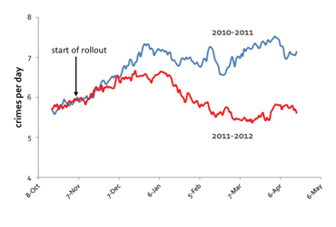
Geographic profiling
“Very soon, we will be moving to a predictive policing model where, by studying real time crime patterns, we can anticipate where a crime is likely to occur.”
Chief William Bratton, Los Angeles Police
Testimony to US House
September 24, 2009
predpol.com
Profile identifies higher crime area
  Small area, 500 sq ft to avoid profiling neighborhoods
Must be corroborated by witnessed criminal activity
What about police “stops” outside the profiled area?

Slide 33
Criminal Profiling
“Computerized” tips and profiles
  Predicting crime for specific individuals
  Courts have held that profiling is a reasonable factor
Violates punishment theory of equal chances of getting caught
Ratcheting creates a closed loop of confusion
Self-fulfilling prophecy by controlling profile

Slide 34
Summary
Big data inferences are thought, not crime
Speech and action could be criminal
… So think carefully
Check us out
  Classifier available on http://github.com/inome
  APIs for exploring people data at http://developer.inome.com

Slide 35
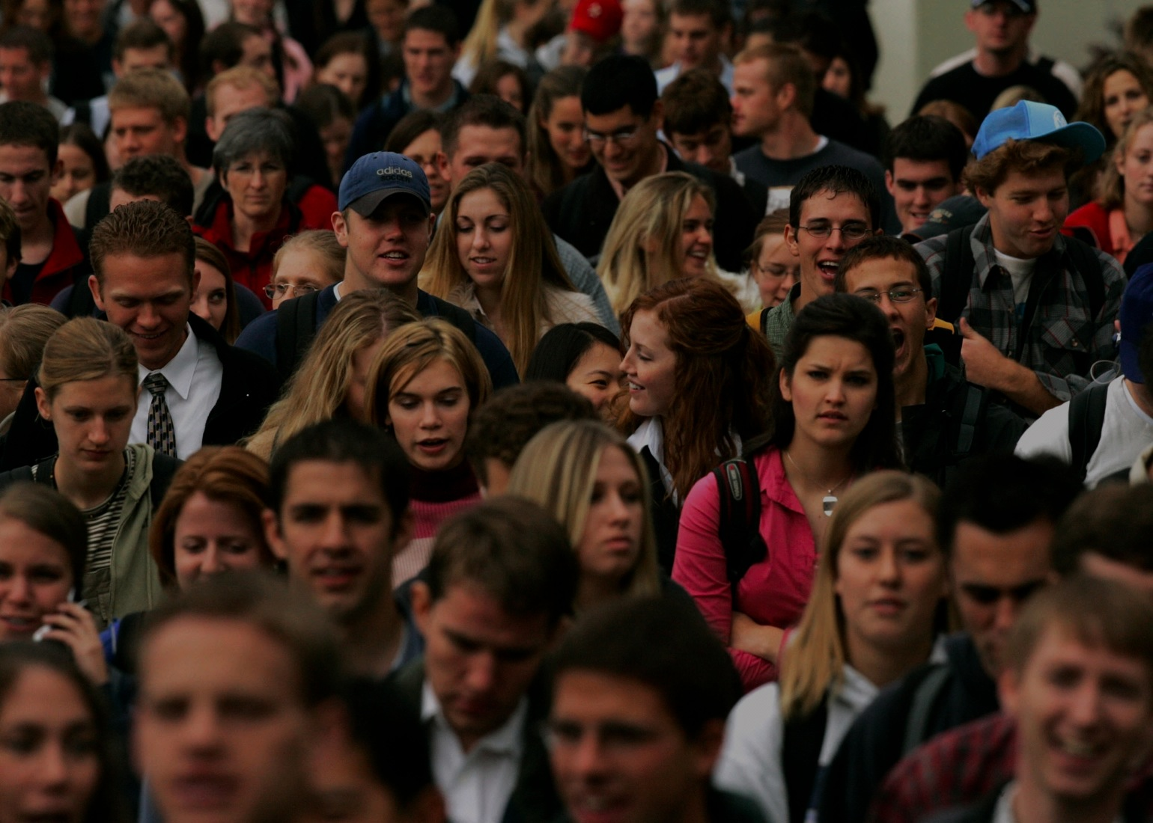

Jim Adler
VP Data Systems & Chief Privacy Officer
inome
@jim_adler
http://jimadler.me
It’s in inome

